Slide 1
Fiscal Year 2024
Budget Overview
Looking Forward
Notes:
Good Evening, I am so pleased and proud to stand before you this evening to present the FY24 budget for the Auburn Public Schools This collaborative effort between staff, administrators and central office reflects our commitment to our students and a respect for the support the townspeople of Auburn provide to us.

Slide 2
WE ARE AUBURN
MISSION
Strengthening connections through Rigor, Relevance, and Relationships
VISION
Our vision is to educate and prepare students for the opportunities and challenges of a changing world.
Our Commitment
We will create, maintain, and support an environment that fosters a sense of belonging for all students in our schools without regard to race, color, sex, religion, national origin, sexual orientation, gender identity, homelessness, poverty, spoken language and ability.
Notes:
Our mission and vision continue to reflect our commitment to preparing our students for the opportunities and challenges of a changing world. We are also committed to creating, maintaining and supporting an environment that fosters a sense of belonging for all students in our schools without regard to race, color, sex, religion, national origin, sexual orientation, gender identity, homelessness, poverty, spoken language and ability.

Slide 3
School Committee Priorities FY 24
Budget reflects the updated 2023-2026 Strategic Plan adopted by the School Committee in February of 2023
The Strategic Plan has been integrated with recommendations of the Equity Audit completed in Spring 2022
The Strategic Plan reflects our commitment to ensuring that all students have a sense of belonging in our schools, they feel safe in our schools and they are being supported and challenged to reach their full potential
While we remain committed to the academic achievement of our students, we are also committed to their social and emotional well being
Notes:
The FY24 budget reflects the goals found in the 2023-2026 Strategic Plan adopted by the School Committee this past February. This plan reflects the recommendations from the Equity Audit conductors in the spring of 2022 and works to ensure that all students have a sense of belonging in our schools, they feel safe and they are challenged to reach their full potential. Our commitment to academic achievement and the social and emotional well being of our students remains strong.

Slide 4
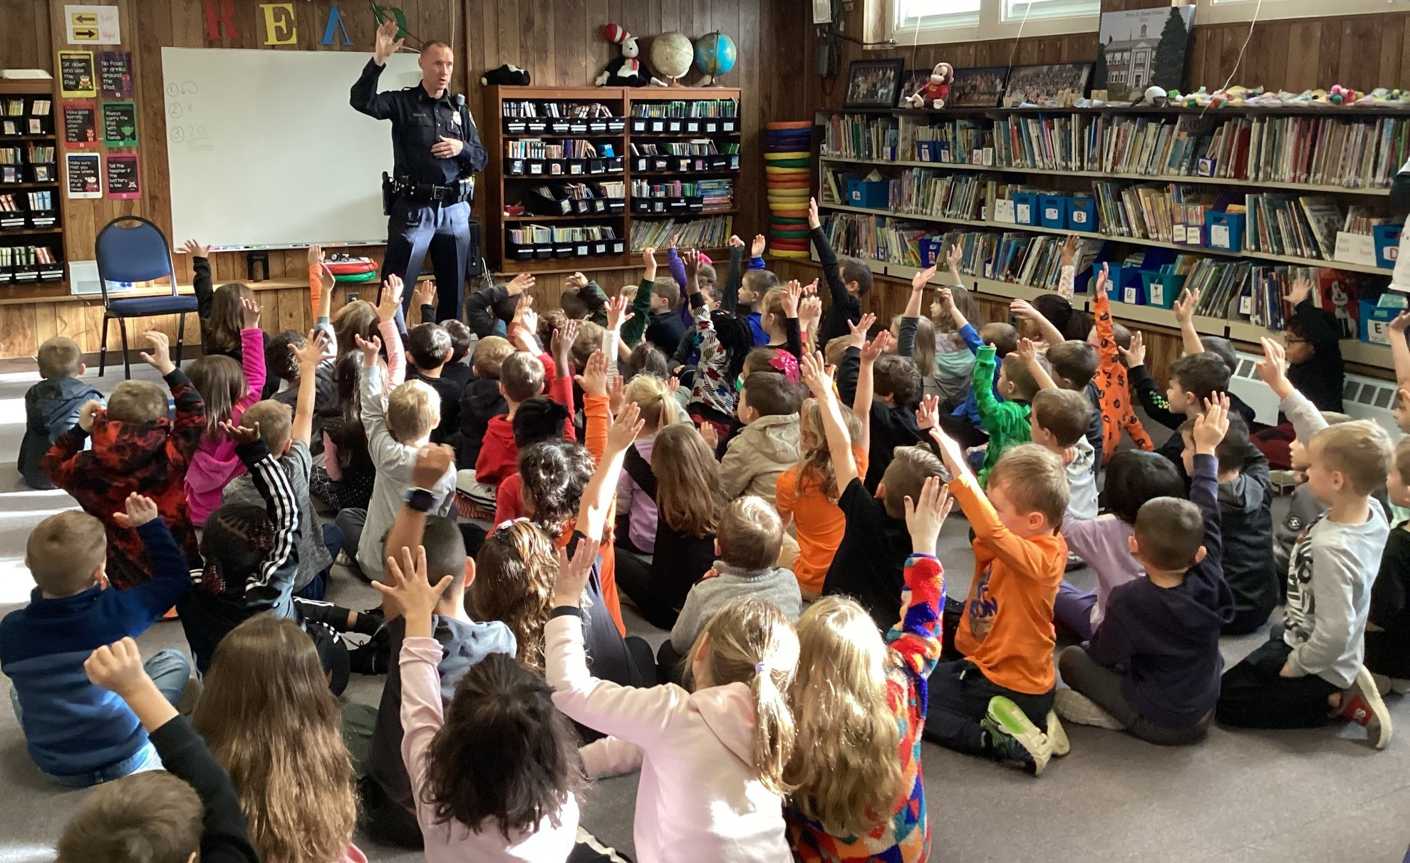
Strategic Plan 2023-2026
TEACHING AND LEARNING
Enhance Social-Emotional Learning Supports District Wide
Create Cohesive Content Programming District Wide
Collaboratively expand educators’ understanding of what culturally conscious teaching, high expectations, and academic success for each and every student means
HEALTH, WELLNESS, AND SAFETY
Continue to Monitor and Enhance Safety Procedures across the District
Promote Social and Emotional Health in All Schools
Enhance District-Wide Nutrition and Healthy Lifestyles
COMMUNITY PARTNERSHIPS
Foster Civic Engagement at the Global, National and Local levels
Utilize and Streamline Community Resources for Partnerships
Effectively communicate with families and the community
Notes:
The recently adopted Strategic Plan identifies three areas of focus: Teaching and Learning, Health, Wellness and Safety and Community Partnerships. In Teaching and Learning, the overall focus is on providing students with rigorous academic, social emotional learning opportunities in a culturally conscious and inclusive learning environment. Health, Wellness and Safety includes initiatives to ensure physical safety, social emotional safety and healthy lifestyles. Community Partnerships has always been a hallmark of the Auburn public Schools and we want to make sure our students become civic minded individuals and that our partnerships with the community and with our families work to enhance the experiences of our students.

Slide 5
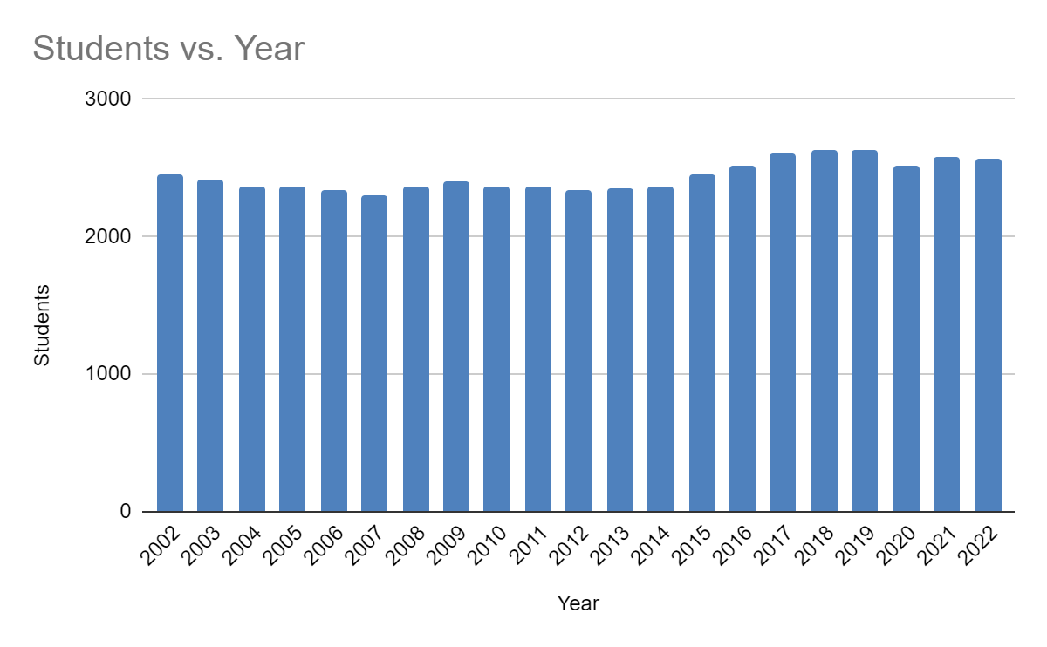
Auburn Public Schools Historical Enrollment
Year Students
2002 2448
2003 2411
2004 2359
2005 2359
2006 2334
2007 2295
2008 2365
2009 2406
2010 2370
2011 2359
2012 2340
2013 2347
2014 2363
2015 2454
2016 2520
2017 2609
2018 2637
2019 2636
2020 2518
2021 2577
2022 2570
Notes:
This is a historical representation of enrollment in the Auburn Public Schools. You will see reflected that our overall enrollment stands at 2570. This is lower that the highest enrollment year of 2018 that was at 2637.

Slide 6
Auburn Public Schools Class Size
K | 1 | 2 | 3 | 4 | 5 | 6 | 7 | 8 | 9 | 10 | 11 | 12
BM/23 PAK/19 | BM/22 PAK/19 | BM/18 PAK/23 | 21 | 22 | 19 | 24 | 24 | 24 | AHS runs between 16-24 based on course selections, some exceptions.
Notes:
Class sizes remain steady for the most part. Although there are fluctuations between the enrollment at Pakachoag and Bryn Mawr that we are working to address.

Slide 7
Auburn Public Schools School Choice Enrollment
 | Enrollment 2022-2023 | Anticipated Enrollment for 2023-2024 |  | School Choice 2022-2023 | School Choice 2023-2024
Grade | # OF STUDENTS | # OF STUDENTS | Additional School Choice Students | By Grade | By Grade
6 | 226 | 170 | 15 | 4 | 15
7 | 210 | 226 |  | 6 | 4
8 | 215 | 210 |  | 7 | 6
AMS TOTAL | 651 | 606 | 621 | 17 | 25
9 | 192 | 175 | 10 | 10 | 17
10 | 175 | 192 | 5 | 15 | 15
11 | 173 | 175 |  | 20 | 15
12 | 194 | 173 |  | 13 | 20
AHS TOTAL | 734 | 715 | 730 | 58 | 67
Notes:
This year, we have 17 school choice students at AMS and 58 at AHS for a total of 75. For the 23-24 school year, the School Committee has approved an additional 15 at both AMS and AHS. This increase is due to 13 graduating school choice seniors and a smaller incoming grade 6 class. We are not sure if these spots will be all be filled as School Choice applications are accepted through the end of March.

Slide 8
Auburn Public Schools Free and Reduced Lunch
School | Free | Reduced | Total F & R | Paid | Total Enrollment | Total Percent F & R 22-23 | Total Percent F & R 21-22
Bryn Mawr | 90 | 7 | 97 | 176 | 273 | 36% | 37%
Pakachoag | 58 | 8 | 66 | 178 | 244 | 27% | 32%
AMS | 182 | 19 | 201 | 463 | 664 | 30% | 30%
AHS | 205 | 21 | 226 | 646 | 872 | 26% | 31%
SWIS | 140 | 13 | 153 | 400 | 553 | 28% | 29%
TOTAL | 675 | 68 | 743 | 1863 | 2606
Notes:
The data reflects a slight decrease in the number of students who qualified for free and reduced lunch from last school year. However this is most likely due to the fact that school lunch was again free for all students this year and families, therefore did not apply for this option. We continue to wait for information from the state legislature to see if free lunch for all students will continue into the next school year.

Slide 9
Fiscal Year 2024
Considerations
We have maintained staffing levels to meet the class size recommendations of the School Committee (25 or less at the elementary levels and appropriate at the middle and high school levels). We have also maintained staffing levels to meet the special education needs of students with disabilities
October 1st student enrollment counts were used in the decision making process
School based materials and supplies have been nearly level funded for all school buildings
The only new positions you will see reflected are based on student need: (1.0) Special Education Teacher and (1.0) ABA for a Substantially Separate Classroom at SWIS
Emphasis on the social and emotional well being of students to better allow access to content

Slide 10
Fiscal Year 2024
Considerations
Instructional Assistants (IAs) and Applied Behavioral Analysis Instructional Assistants (ABAs) have been noted in their current assignments, although movement is certain to occur to meet student needs
We have worked to maintain a robust nursing corps including an enhanced Lead Nurse position
We have level-funded grant monies using the FY 23 amounts for the 240 grant (IDEA), the Title I grant and the Title IIA grant as offsets to reduce the impact to the operating budget
We have projected the Medicaid reimbursement to be $125,000 as adjusted and approved at the Fall Town Meeting, while also anticipating the use of any carryover funds from previous years, if available
Special Education Circuit Breaker reimbursement is anticipated conservatively at 70% for FY 24 Budgeting purposes
The busing registration fees will be utilized to provide $145,000 from the revolving fund as an offset to the budget

Slide 11
Fiscal Year 2024
Considerations
Continued use of offsets from revolving accounts, which include building rentals, Satellite and Galaxy accounts, as well as the Preschool and Athletic Revolving accounts
Participate in School Choice Program with current filled seats at 75, as previously approved by School Committee with the potential of 92 for FY24
As was the case in FY 23, we have budgeted for 11 regular education school buses, making the assumption the same number of students will ride the bus as planned for this year
Increases in electricity, fuel, and contracted services, are being seen across the country and these increases to the budget have been reflected as well
Oil pricing for FY 24 was bid in conjunction with the French River Collaborative and the price will be $3.0442 per gallon. The current Electricity Contract has been recently negotiated with the Town and we have seen a 30% increase in electricity costs from our previous contract which ended this past May.

Slide 12
Fiscal Year 2024
Considerations
Continued use of Solar Credits from roof top arrays at AMS and AHS, along with the credits received from the Town Solar Project in Rutland have been anticipated to assist as offsets to our electrical costs in FY ‘24.
Projected offsets totaling $3,737,040 are utilized in this budget, which include $501,442 in ESSER Funds that are a one time source of funding for the District.
There is a 14% unanticipated increase in special education private school tuitions for students in out of district placements as determined by the Operational Services Division of the Commonwealth of Massachusetts Executive Office for Administration and Finance. Based on continued uncertainty with state funding, it may require the utilization of funds from the School Department’s Special Education Stabilization account for approximately $ 100,000, which is yet to be determined.

Slide 13
Final Thoughts
AUBURN PUBLIC SCHOOLS
FY24 BUDGET
We present to you tonight a draft budget of $ 30,132,276
This reflects an increase of $ 1,159,206 over the FY 23 Amended Budget of $ 28,973,070
This increase results in a 4.00% increase over the FY 23 Amended Budget

Slide 14
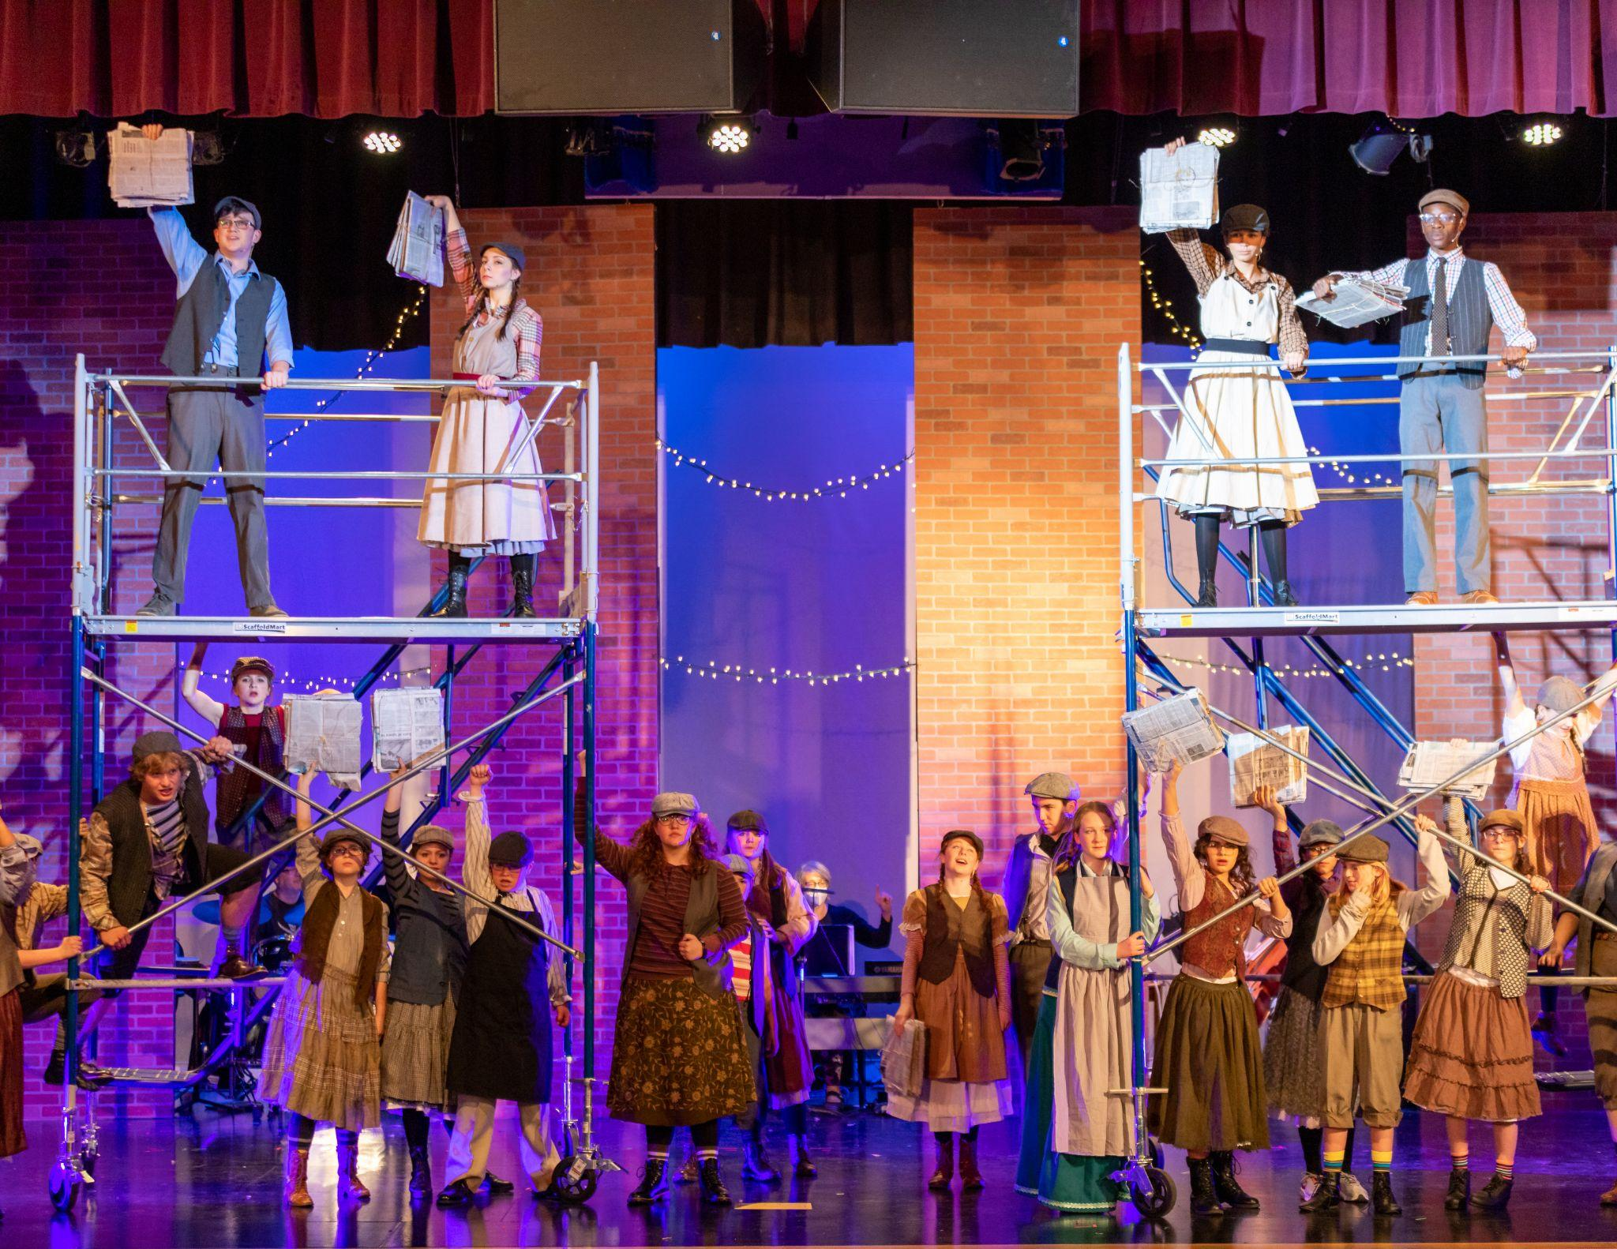
Final Thoughts
AUBURN PUBLIC SCHOOLS
FY24 BUDGET
We are so grateful to be a part of the Auburn Community
We are committed to each and every student in our schools
We are respectful and thankful for the ongoing support we have received from the School Committee and the Town of Auburn
We welcome your questions
“History will judge us by the difference we make in the everyday lives of children.”~Nelson Mandela

Slide 15
Thanks
Do you have any questions?
your email@freepik.com
+91 620 421 838 yourcompany.com
Please keep this slide for attribution

