Slide 1
APS Fine Arts
FY21 Budget
Virginia Bailey & Maria Garrow
Co-Directors
November 18, 2019

Slide 2
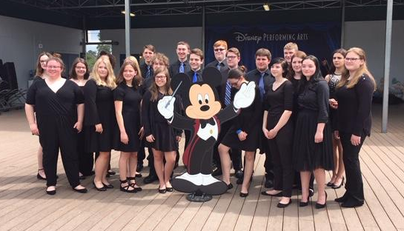
AUBURN PUBLIC SCHOOLS Fine Arts Department
Serves APS students in Preschool to Grade 12
Staff includes: 6 -1.0 FTE Music Educators (Grades 3 to 12) and 1-.9 FTE Music Educator (Preschool to Grade 2):
4 -1.0 FTE Art Educators (Preschool-Grade 2; Grades 3 to 5; Grades 6 to 8; Grades 9 to 12)
Instrumental performing ensembles from Grades 3 to 12
4th year of APS Strings Program, Grades 3 to 6
Choral performing ensembles from Grades 6 to 12
Specialized Art electives at AHS
“Art From the Heart” self-expressive Art classes in Grades Kindergarten to 5
Kindergarten to Grade 12 participation in Worcester Museum of Art’s “Youth Arts Month”
Award-winning AHS Rocket Marching Band
AcaRockets Acapella ensemble, AHS Chamber Choir and AMS Select Chorus
Notes:
2

Slide 3
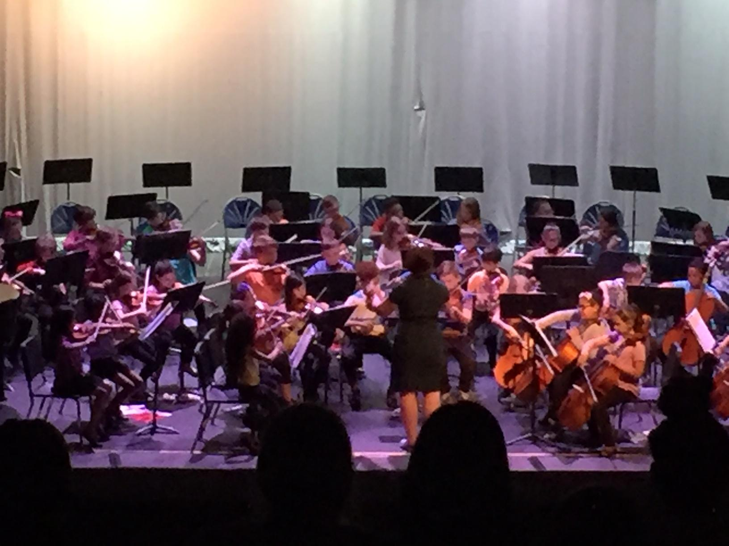
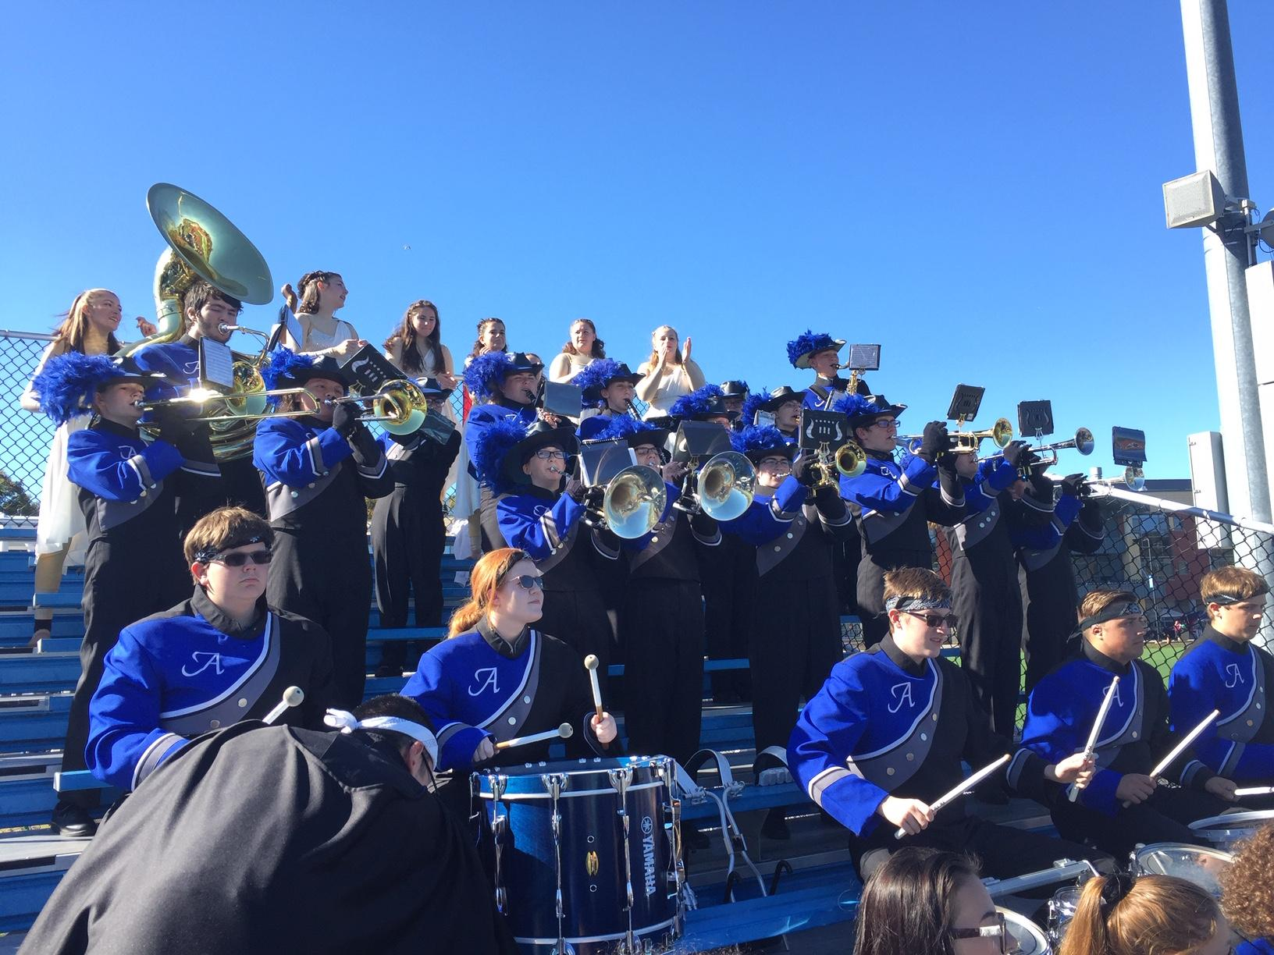
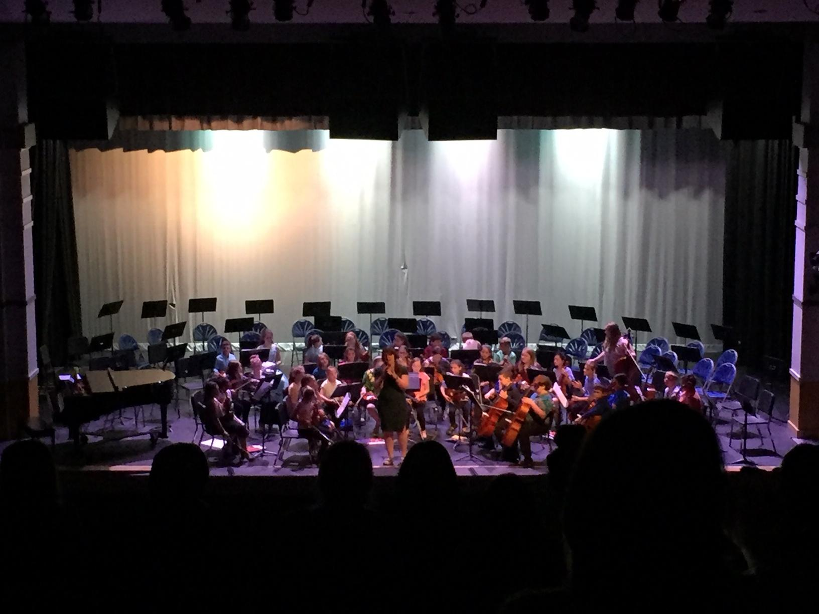
AUBURN PUBLIC SCHOOLS Fine Arts Department
CURRICULUM AND PRACTICE
MA Frameworks and National Fine Arts Standards based lessons and programming (new MA Frameworks under review)
Preschool Instruction: once in a 6-day cycle
Kindergarten to Grade 5: twice in a 6-day cycle
SWIS Instrumental (Band/Strings): before & after School instruction
AMS General Music and Art: Trimester system, 7-day cycle
AMS Performing Ensembles: within school day
AHS Art, Music, and Drama Electives; including AP Music Theory & AP Studio Art: Trimester system
AHS Performing Ensembles: within school day
AHS Art Electives: within school day
AHS Extracurricular Ensembles include AcaRockets, Chamber Choir, Marching Band and Jazz Band

Slide 4
AUBURN PUBLIC SCHOOLS Fine Arts Department
ANTICIPATED FINE ARTS ACCOMPLISHMENTS- FY20
Successful expansion of Strings program to Grade 6- shared staff between SWIS/AMS utilizing a flex schedule
Hosted Competitive Marching Band MICCA Show
Purchase of Choral Uniforms for Chamber Choir to provide a formal, professional look for concerts/events
Additional collaboration with Worcester Youth Orchestras/Ensembles with AHS (October 29th Wind Concert) and Stringapalooza
Return of Winter Play The Little Match Girl

Slide 5
AUBURN PUBLIC SCHOOLS Fine Arts Department
ANTICIPATED FINE ARTS ACCOMPLISHMENTS- FY20 (cont)
Revised Festival of Arts, STEM, and Wellness to promote greater visibility, attendance, and performance opportunities
Return of district traveling art exhibit
Participation in Worcester Art Museum Youth Art Month
Expanded service projects and community outreach with Tri-M
New 6-day rotating schedule for Specials in Grades Kindergarten to Grade 2
Expanded instruction for Auburn Integrated Preschool

Slide 6
AUBURN PUBLIC SCHOOLS Proposed FY21 Budget - Fine Arts Department
FY2020 FY 2021
FA Office Supplies $565 $565
FA Travel Expenses $525 $525
FA Dues $135 $135
Transportation $13,500 $16,000
Music Staff Duties $3,000 $3,000
Awards/Other $1,200 $1,200
Equipment Repair/Maintenance $5,500 $5,500
Band/Choral Uniforms $4,000 $4,000
HS Equipment $6,500 $6,500
Notes:
6

Slide 7
AUBURN PUBLIC SCHOOLS FY21 Budget - Fine Arts Department
FY 21 GOALS
STAFFING
New position- .6 FTE strings teacher*
*Reflected in AMS FY 2021 Budget. We are currently working to identify alternative ways of continuing the Strings program into Grade 7 without adding an additional position.
Will allow current SWIS General Music teacher/Strings teacher to expand Strings curriculum
May allow for reimplementation of SWIS Honors Chorus and All-Town Children’s Chorus
Preschool to Grade 5 supplies: New risers for Pakachoag & Bryn Mawr through CIP funds; Preschool Music and Art supplies through Preschool Revolving account; Purchase of classroom instruments and supplies with CIP funds
Notes:
7

Slide 8
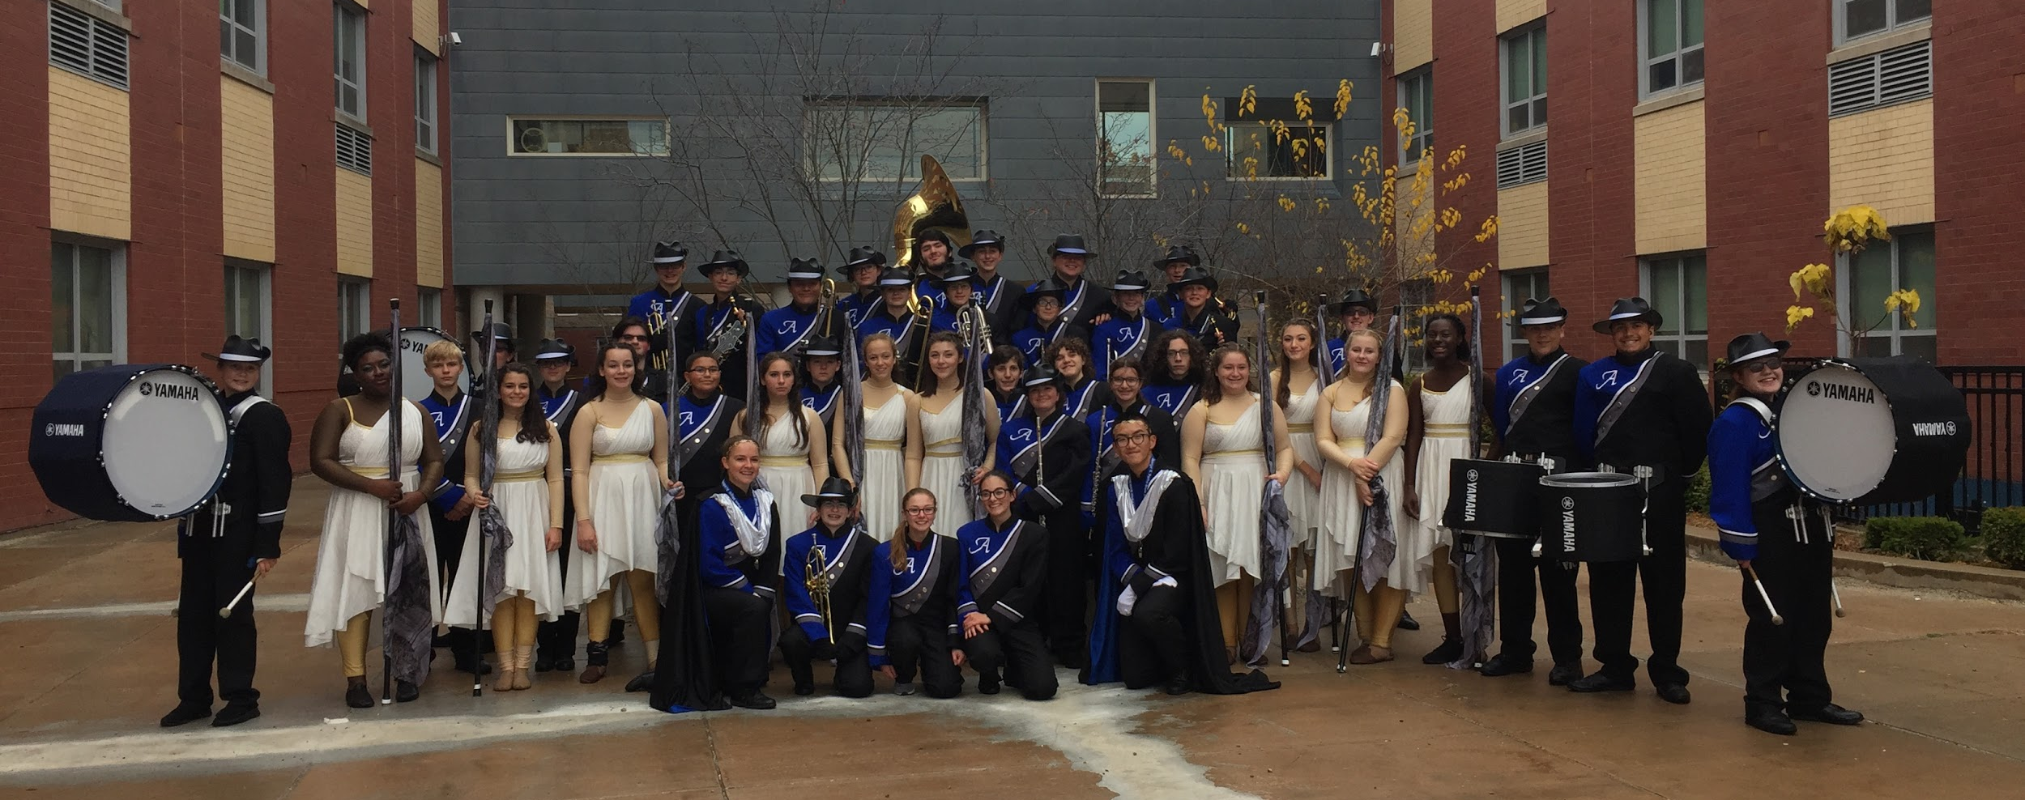
AUBURN PUBLIC SCHOOLS FY21 Budget - Fine Arts Department
CHORAL AND BAND UNIFORMS
Purchase of professional Choral uniforms for AHS
Purchase of thematic Color Guard uniforms
Cleaning and repair of Marching Band uniforms
REPAIR AND BAND EQUIPMENT
Dedicated funds allocated to Drill and music licensing
Continue to maintain and replace aging instruments
TRANSPORTATION
$2,500 increase to allow for additional transportation for Marching Band competitions
Notes:
8

Slide 9
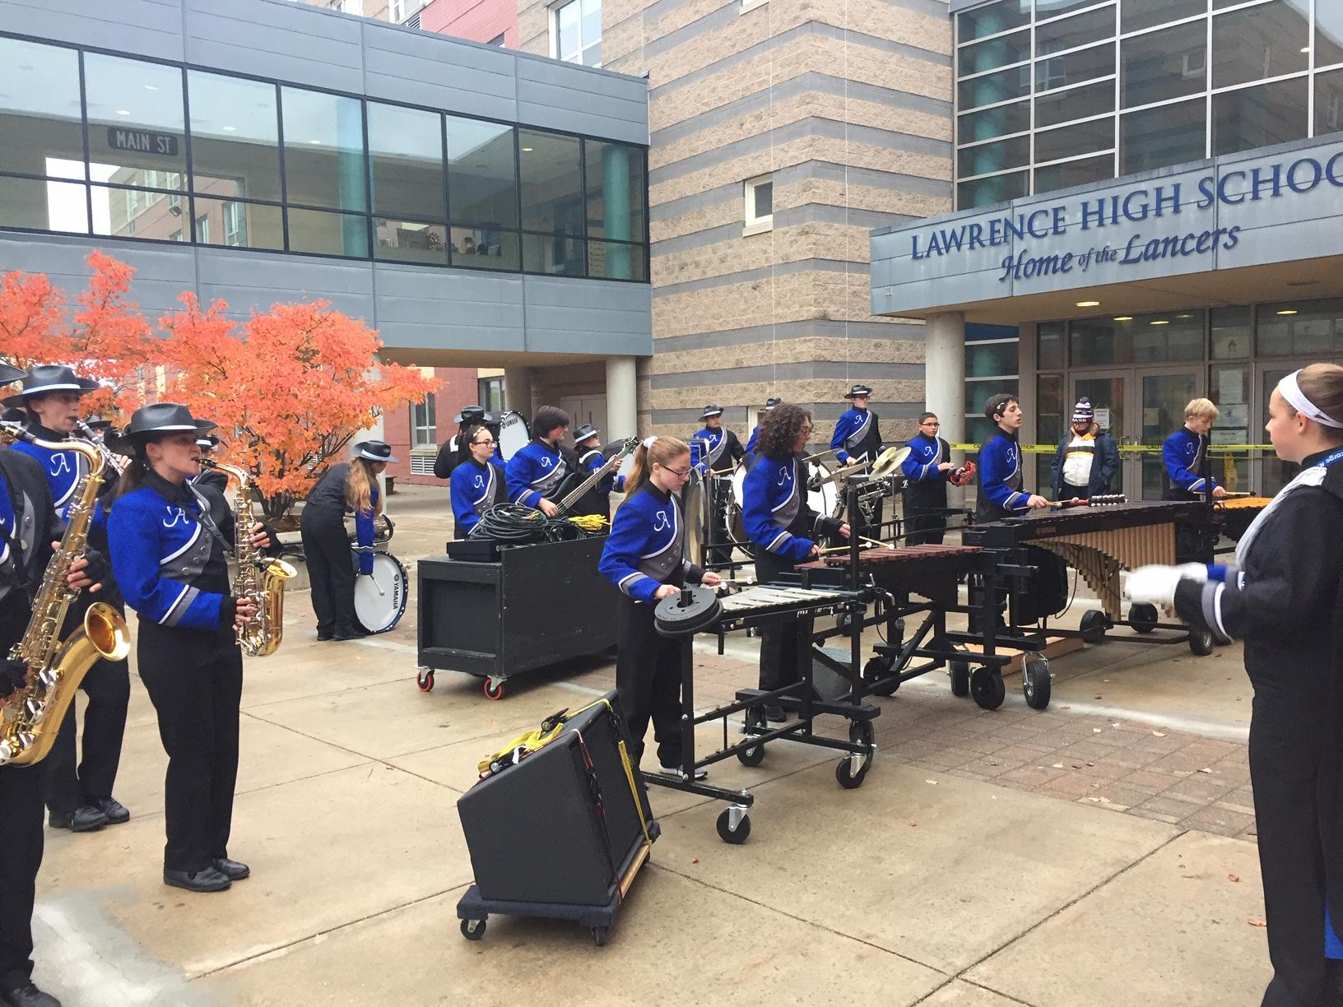
Fine Arts Long Term Goals
Reinstitution of All-Town Children’s Chorus and SWIS Honors Chorus
Expanded participation in Marching Band competitions throughout New England
Addition of Digital Media Arts Specialist in a future year
Expansion of Strings Program to include Grades 7 and 8
Expansion of Strings Program to include AHS Symphony
Additional Extracurricular Opportunities including Winter Guard and Competitive Indoor Percussion

Slide 10
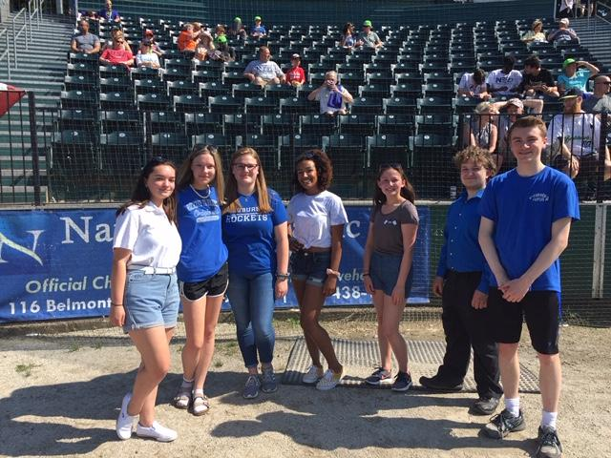
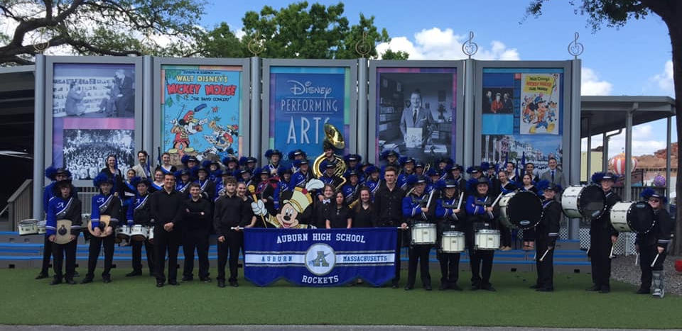
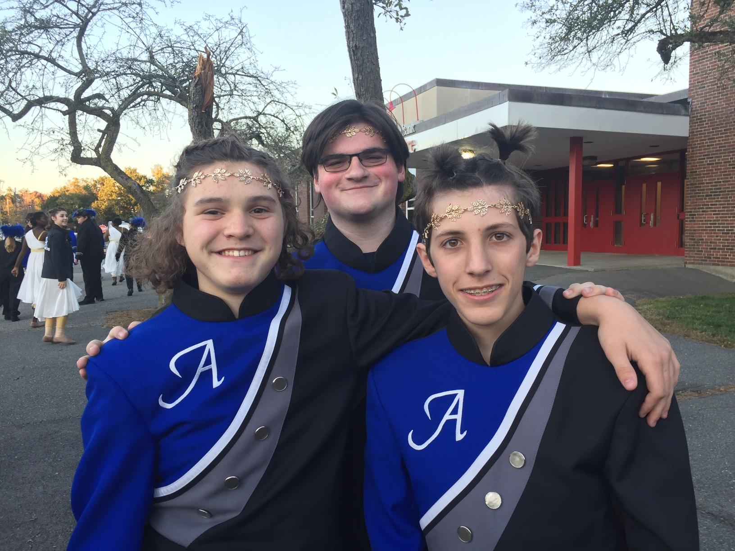
Thank you for your continued support of our programs!

