Slide 1
Reading Specialists
Mrs. Saad - Reading Specialist Mrs. Bergeron - Reading Specialist

Slide 2
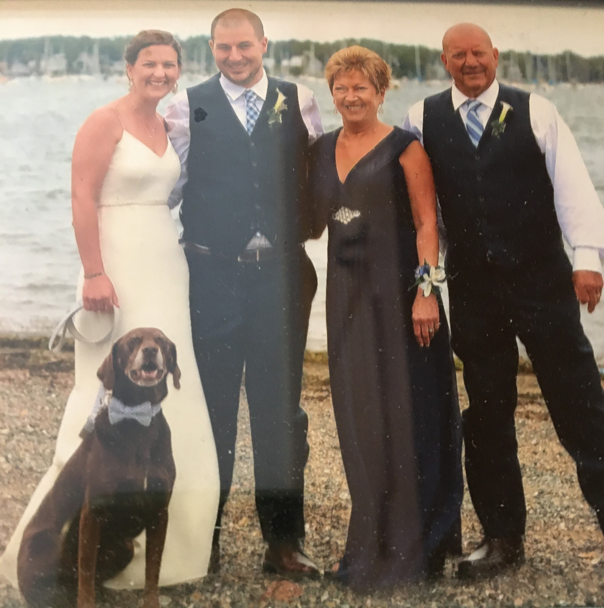
Welcome students and families to Swanson Road Intermediate School. My name is Mrs. Saad. I am one of the Reading Specialists at Swanson Road. I have worked in Auburn as a Reading Specialist for 16 years.
This is my family. Mr. Saad,our son Brian,his wife Ashley and Colby.

Slide 3
Mrs. Bergeron
Once upon a time there was a little girl who dreamed of being a teacher. She loved to read to her stuffed animals and write in her journals. With hard work and support from people who believed in her, that little girl eventually graduated high school and then college. In 2003, her dream became a reality and now she shares her passion of reading and writing with the students she teaches. She is teaching happily ever after at SWIS and can’t wait to work with you!
That little girl was me,

Slide 4
Our Role:
Administer reading assessments to collect data to inform instruction.
Provide reading/writing support in classrooms
Determine appropriate interventions to address weaknesses/strengths in reading
To help all students become independent readers, writers and thinkers.

Slide 5
Benchmark Assessments Administered:
Dynamic Indicators of Basic Early Literacy Skills (DIBELS)
Nonsense Word Reading (CLS and WWR) -grade 3 only
Word Reading Fluency - grade 3 only
Oral Reading Fluency (WPM/Accuracy)- grades 3, 4 and 5
KeyPhonics Screener
i-Ready Diagnostic Test
Phonemic Awareness
Phonics
Vocabulary
Comprehension Literature and Informational

Slide 6
By the End of Third Grade, Students Can:
https://drive.google.com/file/d/1uya8xh3JZ8twXEsy5Vtk8L31bTagG8dL/view?usp=sharing
3

Slide 7
By the End of Fourth Grade, Students Can:
https://drive.google.com/file/d/1uwyZ6CP1ex8rbjHt2e62HIL2sudXEVCe/view?usp=sharing
4

Slide 8
By the End of Fifth Grade, Students Can:
https://drive.google.com/file/d/1utFpMle44tSI7gbc-wW0aLLu0PmfA0Mk/view?usp=sharing
5

Slide 9
How you can Help your Child as a Reader:
*Reading a book aloud to your child that is above their reading level helps improve the child’s listening comprehension and builds vocabulary.
*Asking your child about the book they are reading and discussing it in a natural way with them will encourage them to share their thinking about reading.
*Taking turns sharing the reading responsibility with your child will help support fluency.
*Encouraging your child to do their best on the i-Ready assessment will help your child’s teacher get an accurate picture of where they are as a reader. i-Ready lessons are determined based on their performance on this assessment.
*Encourage your child to complete i-Ready lessons that focus on areas of weakness.

