Slide 1
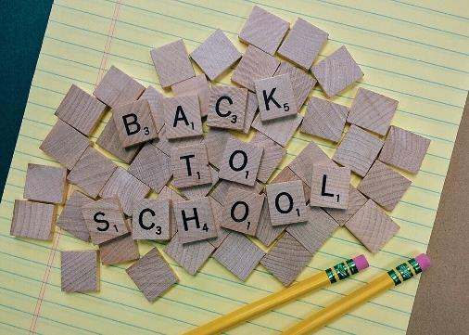
Welcome 3rd Grade Families!

Slide 2
3rd Grade is a huge year for your child’s growth; physically, emotionally, and academically.

Slide 3
A Day in the life of your child
Curriculum
Homework
Other important stuff

Slide 4
Classroom Culture
Hug, Handshake, High Five, or Elbow Tap
Morning Meeting
Classroom Jobs
Alternative Seating
Groupings/Partners

Slide 5
6 Day Rotating Schedule
-P.E. (SNEAKERS)
-Music
-Art (90 days)
-Tech. (90 days)
-SWIS Support

Slide 6
English Language Arts
A wide variety of fiction and non-fiction (expository) selections: Wonders Curriculum
Writing, spelling, grammar and oral language
Ongoing assessment in fluency, decoding, vocabulary and comprehension
In addition, DIBELS and iReady Assessments are given

Slide 7
Go Math
Excellent vocabulary, technology, and strategies
When your child has math homework, the day’s lesson will be sent home with it as a resource
We will focus on specific strategies to teach to mastery
Homework: preparation for assessments

Slide 8
Math Facts
It is important for students to be studying their math facts EVERY NIGHT
By the end of grade 3, all students must master subtraction, multiplication, and division facts
Many Apps are available & xtramath.org
Notes:
8

Slide 9
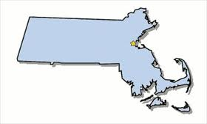
Social Studies
We will study six units in Social Studies all about MASSACHUSETTS!
Maps
Native Americans
Explorers
Pilgrims
Puritans
Revolutionary Times
There are so many historical sites to help your child’s understanding of our state’s and country’s history
Notes:
9

Slide 10
Science
Our Science Units:
Motion & Forces
Electricity & Magnetism
Weather
Climate
Life Cycles and Traits
Adaptations and Survival
Fossil Evidence

Slide 11
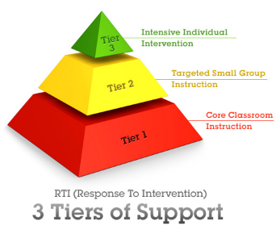
WIN (what I need)
Intervention is very specific to each child’s individual needs.
Some of the things we work on:
Decoding
Common spelling patterns
Vocabulary
Comprehension
Fluency (math and reading)
Math: computation and problem solving
Social Emotional Needs

Slide 12
Homework
Clean out folders and check planners daily
Check for important reminders and upcoming events.
Homework will be Monday-Thursday
Read 15 minutes
Math homework aligned to class lesson
Math Facts
Book Projects (3 total this year)

Slide 13
Snack
Pack a healthy and not too messy snack every day
Water bottles can be left in holder for the week (they will take them home on Fridays to wash them)
NO JUICE!!! We have carpet and the ants will come

Slide 14
Other important Stuff
Class tag will be used to share announcements, reminders, photos, etc.
School Pictures October 5th

Slide 15
Looking Forward to A Great Year!!!
Notes:
15

