Slide 1
Welcome
to
Fifth Grade
2021- 2022

Slide 2
Objective
The fifth grade environment is one that is geared towards helping the students take an increasing responsibility for their own learning which in turn will help them become lifelong learners.

Slide 3
Literacy/Language
Literacy – Reading Component
Wonders Reading Program
Focus on different genres
Content-Area Links extend into science and social studies
Reading comprehension, craft and structure of text, fluency
Vocabulary development

Slide 4
Writing and Language
Writing (opinion and narrative)
Grammar (usage)
Listening and speaking skills
Responding to text and providing text evidence.

Slide 5
Go Math!
Number & Operations in Base 10 (patterns, decimals – add, subtract, multiply, divide)
Number & Operations – Fractions (add, subtract, multiply, divide)
Operations & Algebraic Thinking (writing expressions, patterns and rules)
Measurement & Data (conversions, volume, line plots)
Geometry (coordinates, classification of two-dimensional figures)
Solve real world problems that apply to each area

Slide 6
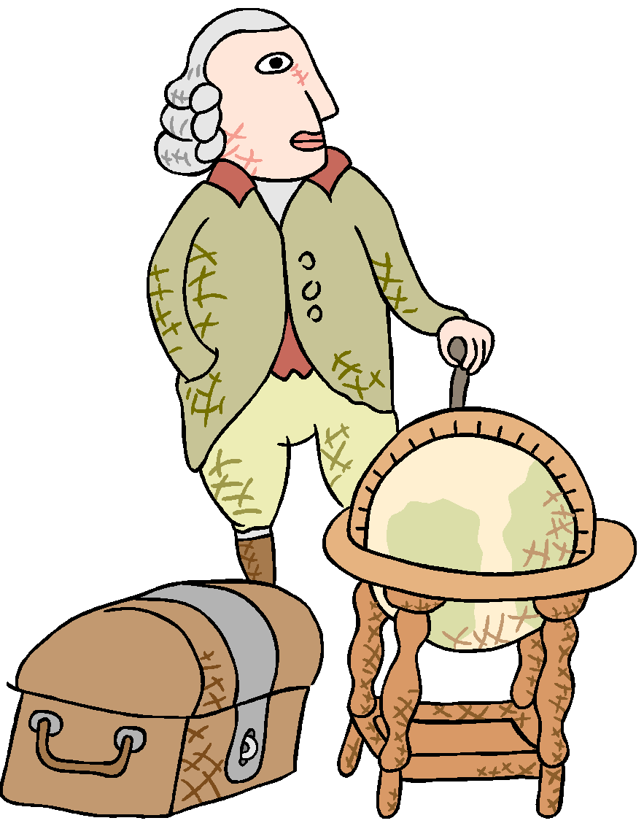
Social Studies
Early colonization and growth of colonies
Reasons for the Revolution & The Revolutionary War
Principles of United States Government
The Growth of the Republic
Slavery, the legacy of the Civil War, and the struggle for civil rights for all

Slide 7
Science
Elevate Science Program
Physical Science (Matter)
Earth/Space Science (Earth’s Systems; Human Impact)
Life Science (Structures, Organisms, Ecosystems)
Using hands on labs
STEM integrated lessons
Virtual lab components and online tests
MyCuteGraphics.com

Slide 8
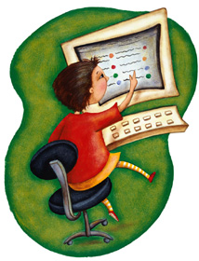
Technology
Our goal is to integrate as much technology into our curriculum as possible. Students are now a 1:1 with iPads for interactive instruction, and our expectations are for students to have good digital citizenship skills.
Students will also be using various websites as reinforcement of math, reading, and science skills at school and at home.

Slide 9
Expectations
Homework – Homework will reinforce skill areas covered in class. It is always due the next day for class unless otherwise specified by the teacher.
Students have a “Student Planner” to keep track of their assignments as well as having the availability of a homework board in each room that if they forget an assignment they are able to view the board for the work.

Slide 10
Assessments
Students’ assessment will be based on classroom work, projects, homework, quizzes, tests, written and oral assignments, and class participation.

Slide 11
Books & Supplies
Classrooms are always looking for donations of tissues and disinfection wipes especially during the winter months.
Please make sure your child’s supplies are replenished throughout the year.
Our desks are filled to the brim with the many books we use throughout the day. Please encourage your child to keep their desks clean, organized and free of unnecessary supplies.

Slide 12
Online Resources
ThinkCentral (Go! Math)
ConnectEd (Reading/Grammar/Writing)
Savvas (Science)
Class Dojo or Class Tag (Communication)), Sign-ups)
Google Classroom
Epic! (in school)
My contact information

Slide 13
We are looking forward to a fun and successful year! THANK YOU FOR COMING!

